Slide 1
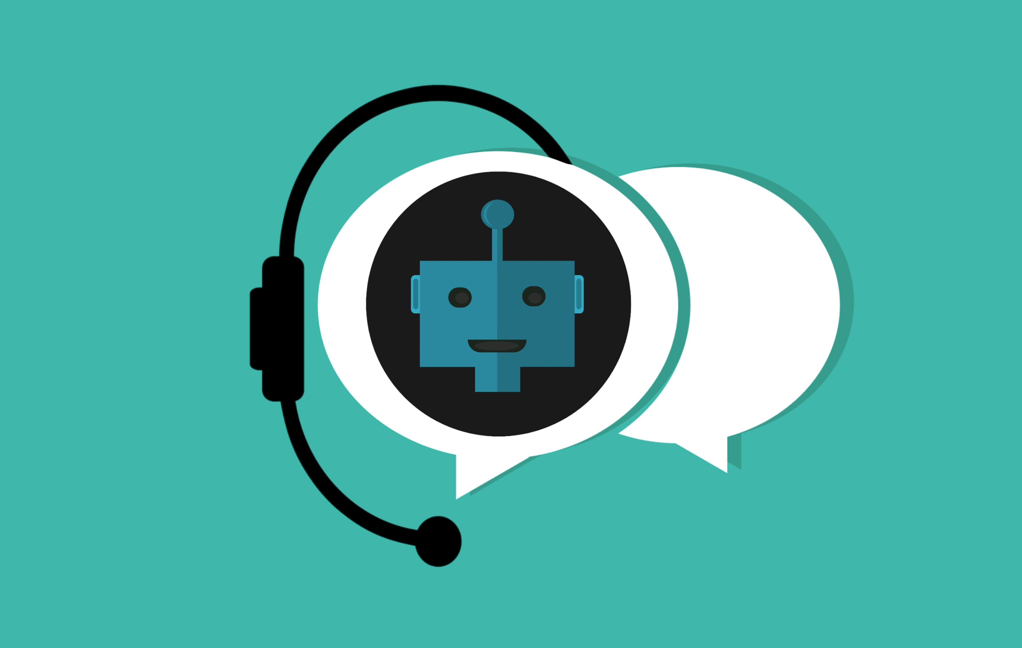
Vernacular Voice Chat-bot
Srishti & Lucky
Mentors : Sarvesh, Pushkar, Shashi

Slide 2
Agenda
1
2
3
4
5
Problem
Speech
LLM
TTS
Future Improvements

Slide 3

Problem
“Many Indian customers struggle with English-first banking apps, limiting financial inclusion.“
"Voice-based assistants in regional languages can bridge this gap."
Solution :
An AI VoiceBot that understands & responds in the user’s language: Hindi, Tamil, Marathi, etc. serving as a Customer Support Agent.

Slide 4
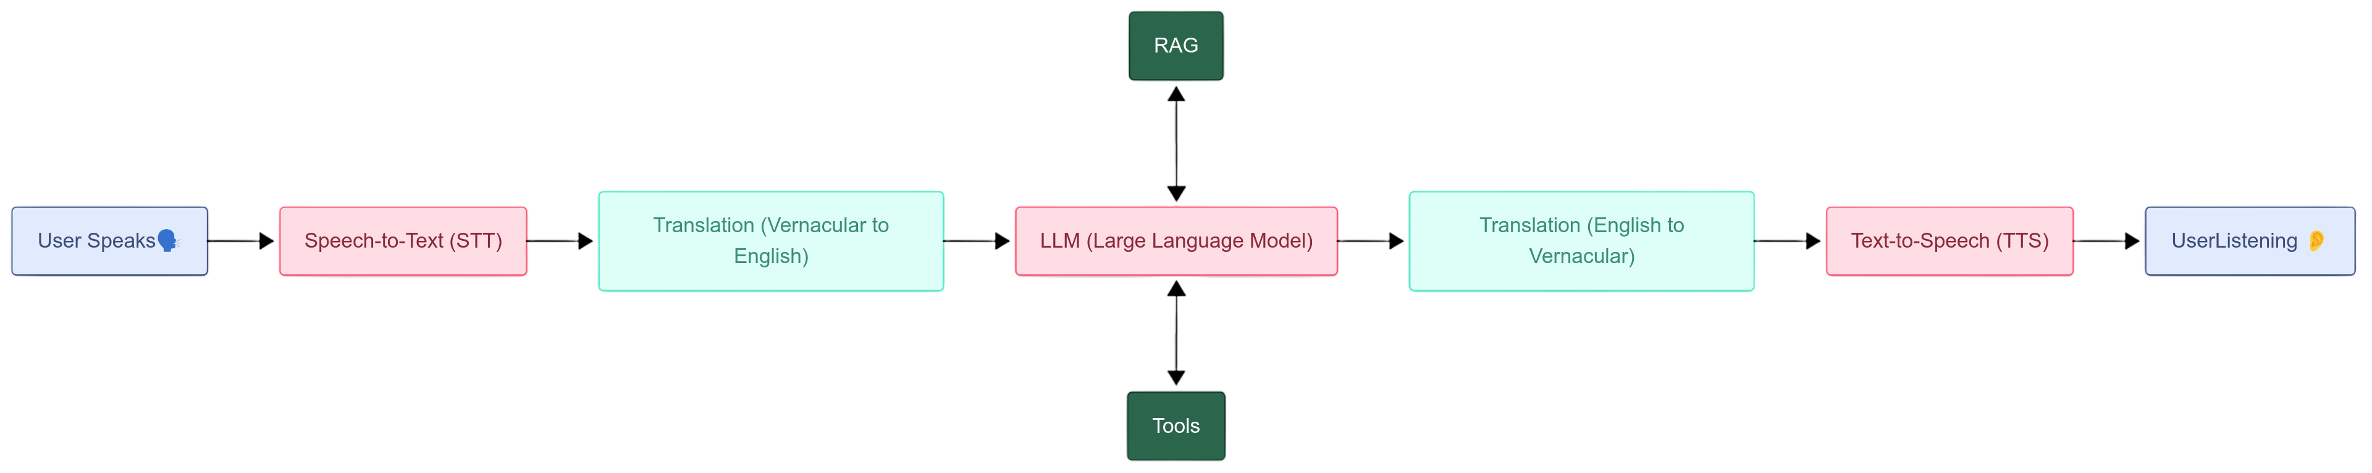
Pipeline

Slide 5
STT and WebRTC
Model
Google Cloud STT
Streaming Audio
Using WebRTC to stream audio from user to server and vice versa.
UI
Using streamlit and streamlit-webrtc for UI and interface.
VAD
Using Google’s VAD model for Voice Activity Detection
Benchmarking
15% WER (Word-Error-Rate) of the STT model when tested on 10 hours of Hindi audio data collected from YouTube.

Slide 6
Challenges faced in STT
Different Uses,
Different Needs
Exploring various formats of speech representations: layout, sample rate, audio format, frame size
Adjusting VAD parameters.
Model Selection
Latency issues: fine-tuned Faster-Whisper models for Hindi
Settled on using Google Cloud’s STT model.

Slide 7
LLM
RAG, Chunking
Intermediate Chatbot
Tools
Storing relevant information in a vector database.
Agentic Chunking: create chunks on a semantic basis rather than simply based off punctuation or pre-defined chunk length.
Written entirely in Langgraph
LLM used: Gemini 2.5 Flash
Performing multiple LLM calls to check for query clarity and sufficiency before the final output.
LLM can ask questions back if user query is incomplete.
Document Search
Finding Branches: Using MongoDBs inbuilt geospatial query feature to ​extract nearest location based on User’s input. ​

Slide 8
Challenges faced in LLM
ChatBot vs VoiceBot
Verbosity: needed to shorten output size for conversationality.
Looping: ends up in a loop of asking questions to form a sufficient query.
Data Quantity +
Quality
Lack of quality Customer Service Data for our RAG mechanisms
Could generate random data to serve as proxy user data for testing.

Slide 9
TTS
Model
Issue: Integration with WebRTC, Interruption Mechanisms
Current workaround:
bypassing streamlit-webrtc for TTS
Using GTTS (Google) Engine via a real-time wrapper (RealTimeTTS package)
Facing threading/blocking issues due to the sparsely documented streamlit-webrtc package.
Automatic interruption mechanisms created processing issues.
Real-time streaming for STT and LLM components -> generation of TTS -> save as .wav -> playing via streamlit
Allows users to manually pause the output speech, if needed, in place of automatic interruption.

Slide 10
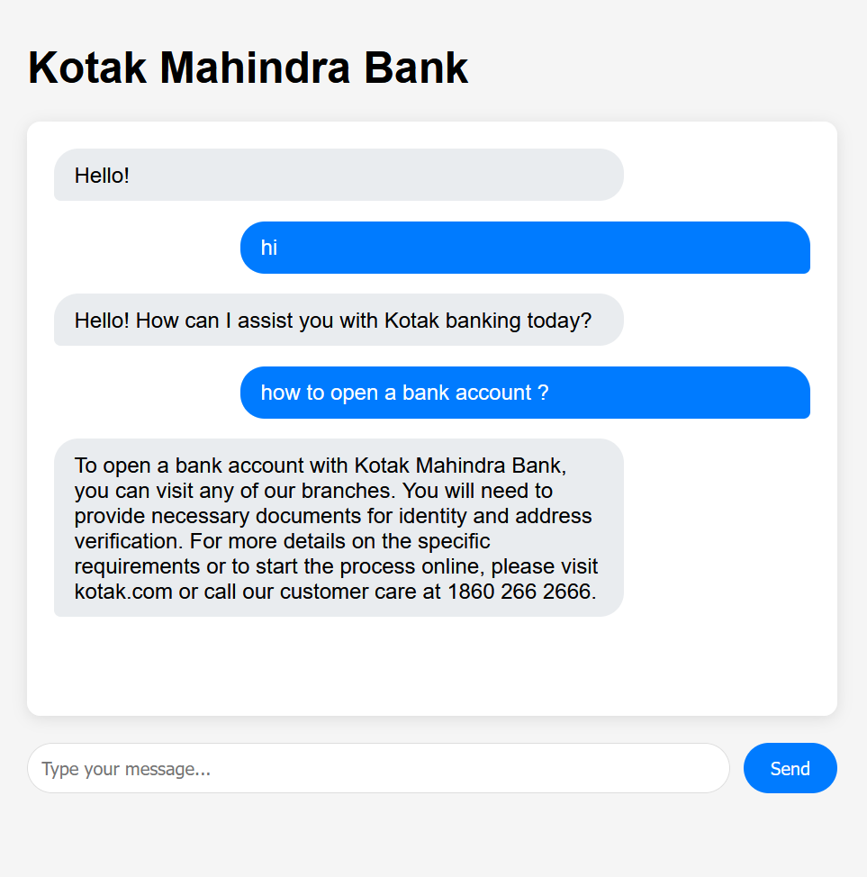
Cloud ?
Created API endpoints for the LLM part only and deployed it to the cloud for testing and integration purposes.
Using Google Run for this purpose.
Currently, the Vectors are stored in the same docker container which is uploaded. Need to outsource this to cloud based vector Databases.
API can be tested through Postman or https://yomaann.github.io/Test-Chatbot/.

Slide 11
Future Improv-ements
Language
Currently only supports Hindi.
Truly real-time TTS
Playing output speech via WebRTC
Dynamic Prompting
Moving away from static prompts and a linear workflow.
Automatic Interruption
Upon detection of user speech
Lower latency, accuracy

Slide 12

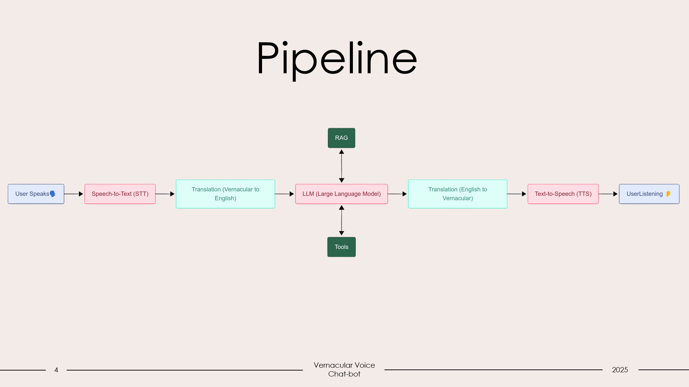
Thank you

